Slide 1


Slide 2

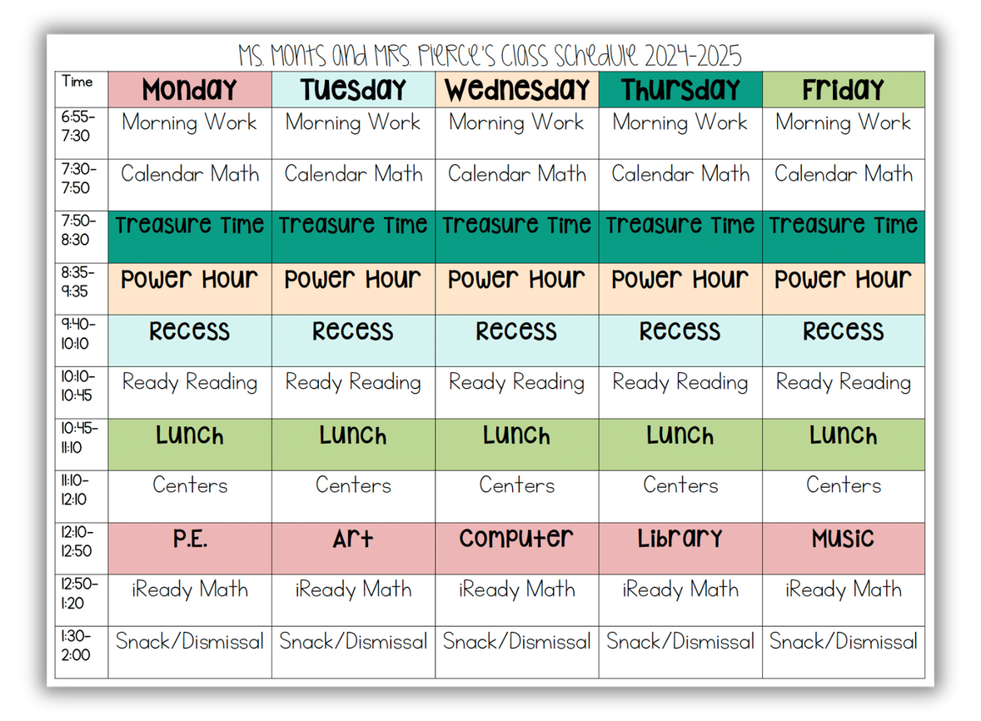
Welcome
It is important to be on time EVERYDAY!
Class starts promptly at 7:30.
Schedule
Dismissal
We dismiss at 2:00 each day, and
1:30 on Wednesdays.
No check-outs after 1:30
(1:00 on Wednesday)
Reminder
If your child is absent, please send an excuse the day they return.

Slide 3

Class Rules
Rule 1: Follow directions quickly.
Rule 2: Raise your hand for permission to speak.
Rule 3: Raise your hand for permission to leave your seat.
Rule 4: Make smart choices.
Rule 5: Keep our dear learning community happy.
The BIG Rule: Listen while your teacher is talking.
The DIAMOND Rule: Keep your eyes on the target.

Slide 4

Classroom Management
My classroom is expected to be a SAFE and LOVING environment!
Color Chart
Procedures
• Warning
• Color change
• Time out
• Corporal punishment or suspension
Pink- Role Model
Purple- Great Day
Blue- Did My Best
Green- Good Day
Yellow- Warning
Orange- Time out
Red- Call home/office
Rewards
  Clip up
  Treasure Box
  Candy
  Priveleges

Slide 5

Transportation
Students must ride the same bus in the morning and afternoon and use the same mode of transportation everyday!
Bus changes must be made in writing first thing in the morning. No changes via phone.
No temporary changes can be made; you can plan to check your child out early if needed.
Car rider numbers must be visible in vehicle, or student will have to be picked up in the front office. You can get duplicates at the front desk!
Car Rider line can get lengthy, so I encourage you to arrive early for drop-offs and pick-ups!

Slide 6



Fees
PTSO Shirts available for $15!
Cafeteria
Fees
Breakfast - $1.75
Reduced - $0.30
--------------------------------------------
Lunch - $3.00
Reduced - $0.40
Guest - $4.00
Apply for free/reduced meals >
Paper Fee $15.00
MySchoolBucks
Pay fees and add money to lunch account with MySchoolBucks!

Slide 7
binders
Check EVERY NIGHT and please keep it clean!
Newsletter
Money
Any money that is sent needs to be sealed in an envelope, labeled, and placed in blue folder!
We do not check backpacks!
The newsletters are your Kindergarten Survival Guides! Read them each week and refer to them for homework, news, reminders, and weekly skills.
READ! READ! READ!
The most important thing you can do each night is talk with your child and read to them!
Homework
ELA: Homework is on the back of the newsletter.
Math: iReady worksheet

Slide 8


Celebrations
Holidays
Birthdays
You may drop off cupcakes (store-bought), treats, goody bags, etc.
Thanksgiving Feast
Come FEAST with us!
Christmas Party
For students only.
Valentine Party
For students only.
Info
Dates and more information for each celebration will come!

Slide 9

Academics
End of Year Expectations
  Know all letters/sounds (by Christmas)
  Spell grade-level words (CVC)
  Read 20 correct words per minute
  Show grade appropriate handwriting
  Write 3 sentences about a topic
  Know all Pre-Primer and Primer words
  Recognize/write numbers to 20
  Count to 100 by 1s and 10s
  Count on from a given number
  Know all 2D/3D shapes
  Add and subtract fluently within 10

Slide 10
Encourage your child to always do their absolute best!!
Testing
ELA & Math
MKAS
Friday is our testing day for ELA. Math tests will fall whenever each unit ends.
Test dates will be on Newsletters.
Check your child’s grades through ActiveParent.
Signed papers will go home every Tuesday.
This is our state test taken at the beginning and end of the year.
BOY goal is 535;
EOY goal is 775.
State goal is 681.
STAR
We will take STAR a couple of times throughout the year as prep for MKAS.

Slide 11

A note from
Nurse Aly
Please keep an extra set of clothes, underwear, and socks in a ziplock bag in your child’s backpack.
Also, if your child has asthma, seizures, or any life-threatening allergy, please let me and the nurse know!
If your child takes medication, it needs to go directly to the nurse.
PLEASE do not send medications in backpacks!

Slide 12

field trip
When & Where
Money
$12 for students
Due September 27
$5 for chaperones
(Pay at the gate)
Friday, October 25
Back 40 Pumpkin Patch
Pelahatchie
Leave PLE at 8:15
Return to school at 1:00
Lunch
Sack lunch from school or home.

Slide 13

Donations
We always accept donations for our classroom treasure box and snack bucket!
Our classroom wishlist!

Slide 14


Communication
jmonts@pearlk12.com
601-932-7976
I use School Status to communicate. Just save the number when a text is sent to you and you may reach me at that number anytime!

Slide 15
Class Schedule

